Slide 1
Airline System

Slide 2
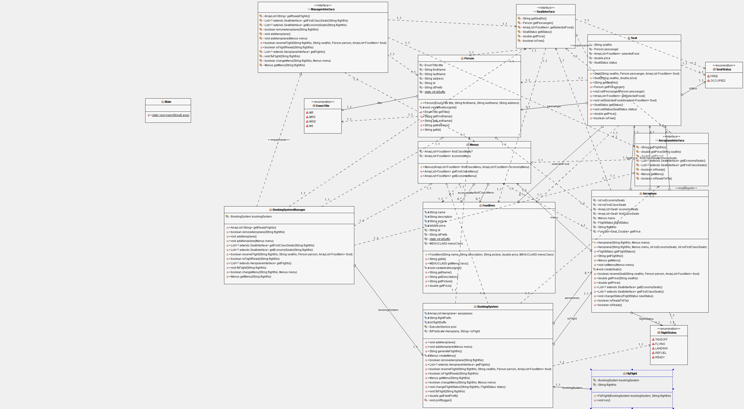
Class Diagram

Slide 3
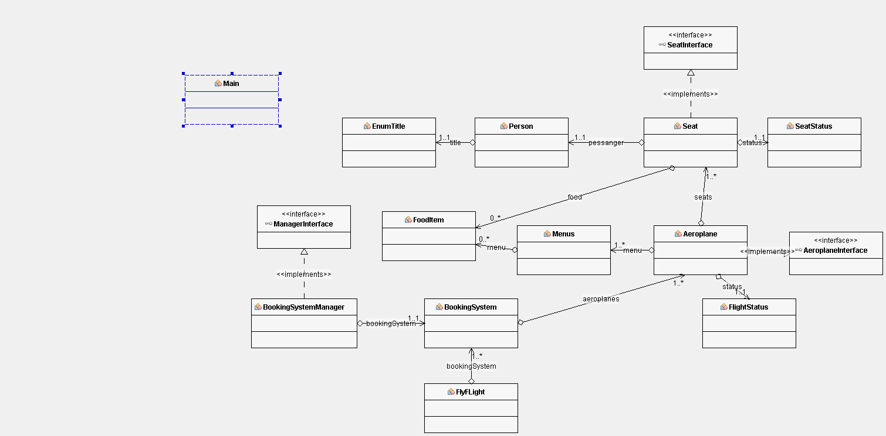
Simplified Class Diagram

Slide 4
Major Points:
Encapsulation
Easily Modifiable
Interactive GUI
Profit in log file

Slide 5
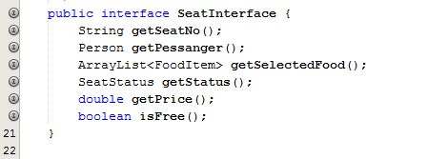
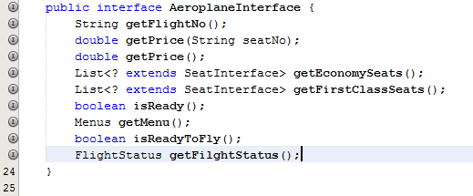
Seat Interface:
Aeroplane Interface:

Slide 6
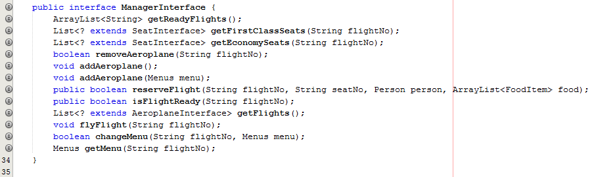
Manager Interface:

Slide 7
Functionality provided by Back-End:
Add an Aeroplane
Modify menu for an aeroplane
Remove an aeroplane
Reserve a seat with selected food items with an aeroplane
Fly an aeroplane in separate thread
Log profit to log file
Read profit from log file

Slide 8
Functionality provided by GUI:
Add an Aeroplane
Remove an aeroplane
Reserve a seat with selected food items with an aeroplane
Fly an aeroplane in separate thread

